Slide 1
Module 4 FILE SYSTEM INTERFACE, MASS-STORAGE STRUCTURE

Slide 2
What is File System?
A file system is a method an operating system uses to store, organize, and manage files and directories on a storage device. Some common types of file systems include:
FAT (File Allocation Table): An older file system used by older versions of Windows and other operating systems.
NTFS (New Technology File System): A modern file system used by Windows. It supports features such as file and folder permissions, compression, and encryption.
ext (Extended File System): A file system commonly used on Linux and Unix-based operating systems.
HFS (Hierarchical File System): A file system used by macOS.
APFS (Apple File System): A new file system introduced by Apple for their Macs and iOS devices.

Slide 3
A file is a collection of related information that is recorded on secondary storage. Or file is a collection of logically related entities. From the user’s perspective, a file is the smallest allotment of logical secondary storage.
The name of the file is divided into two parts as shown below:
name
extension, separated by a period.
Issues Handled By File System
We’ve seen a variety of data structures where the file could be kept. The file system’s job is to keep the files organized in the best way possible.
A free space is created on the hard drive whenever a file is deleted from it.
To reallocate them to other files, many of these spaces may need to be recovered.
Choosing where to store the files on the hard disc is the main issue with files one block may or may not be used to store a file. It may be kept in the disk’s non-contiguous blocks.
We must keep track of all the blocks where the files are partially located.

Slide 4
File attributes
A file has a name and data. Moreover, it also stores meta information like file creation date and time, current size, last modified date, etc. All this information is called the attributes of a file system.
Name: The symbolic file name is the only information kept in human readable form.
Identifier: This unique tag, usually a number, identifies the file within the file system; it is the non-human-readable name for the file.
Type/ Extension: This information is needed for systems that support different types of files.
Location: This information is a pointer to a device and to the location of the file on that device

Slide 5
Size: The current size of the file (in bytes, words, or blocks) and possibly the maximum allowed size are included in this attribute.
Protection/ Permission: Access-control information determines who can do reading, writing, executing, and so on.
Timestamps and user identification: This information may be kept for creation, last modification, and last use. These data can be useful for protection, security, and usage monitoring
Encryption, compression

Slide 6
File Operations
Creating a file: Two steps are necessary to create a file. First, space in the file system must be found for the file. Second, an entry for the new file must be made in a directory.
Opening a file: Rather than have all file operations specify a file name, causing the operating system to evaluate the name, check access permissions, and so on, all operations except create and delete require a file open() first. If successful, the open call returns a file handle that is used as an argument in the other calls.
Writing a file: To write a file, we make a system call specifying both the open file handle and the information to be written to the file. The system must keep a write pointer to the location in the file where the next write is to take place if it is sequential. The write pointer must be updated whenever a write occurs.

Slide 7
Reading a file: To read from a file, we use a system call that specifies the file handle and where (in memory) the next block of the file should be put. Again, the system needs to keep a read pointer to the location in the file where the next read is to take place, if sequential. Once the read has taken place, the read pointer is updated. Because a process is usually either reading from or writing to a file, the current operation location can be kept as a per-process current-file-position pointer. Both the read and write operations use this same pointer, saving space and reducing system complexity.

Slide 8
Repositioning within a file: The current-file-position pointer of the open file is repositioned to a given value. Repositioning within a file need not involve any actual I/O. This file operation is also known as a file seek.
Deleting a file: To delete a file, we search the directory for the named file. Having found the associated directory entry, we release all file space, so that it can be reused by other files, and erase or mark as free the directory entry. Note that some systems allow hard links—multiple names (directory entries) for the same file. In this case the actual file contents is not deleted until the last link is deleted.
Truncating a file: The user may want to erase the contents of a file but keep its attributes. Rather than forcing the user to delete the file and then recreate it, this function allows all attributes to remain unchanged—except for file length. The file can then be reset to length zero, and its file space can be released.

Slide 9
Commonly used terms in File systems
FIELD:
This element stores a single value, which can be static or variable length.
DATABASE:
Collection of related data is called a database. Relationships among elements of data are explicit.
FILES:
Files is the collection of similar record which is treated as a single entity.
RECORD:
A Record type is a complex data type that allows the programmer to create a new data type with the desired column structure. Its groups one or more columns to form a new data type. These columns will have their own names and data type.

Slide 10
File Type
It refers to the ability of the operating system to differentiate various types of files like text files, binary, and source files. However, Operating systems like MS_DOS and UNIX has the following type of files:
Character Special File
It is a hardware file that reads or writes data character by character, like mouse, printer, and more.
Ordinary files
These types of files stores user information.
It may be text, executable programs, and databases.
It allows the user to perform operations like add, delete, and modify.

Slide 11
Directory Files
Directory contains files and other related information about those files. Its basically a folder to hold and organize multiple files.
Special Files
These files are also called device files. It represents physical devices like printers, disks, networks, flash drive, etc.

Slide 12
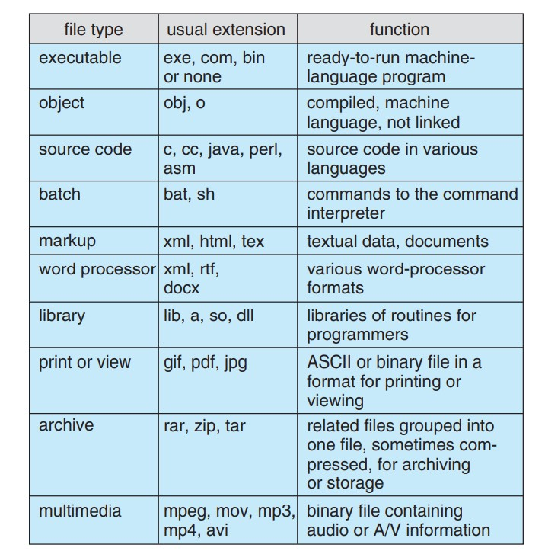
Table: Common File Type

